Slide 1
The development of Variable Plot Sampling by Kim Iles
Metric version

Slide 2
There are only 3 serious methods for timber cruising.
Fixed Plots (ancient, but simple)
Variable Plots (1946, end of WWII)
3P Sampling (1960’s, the beetles)

Slide 3
What is the trend?
Each newer method further divides the field work into parts that are :
Quick vs. slower
Unskilled vs. skilled work
Estimates, with a correction
Efficiency issue
Accuracy issue

Slide 4
Walter Bitterlich had an idea, based on circular tree cross-sections.

Slide 5
Bitterlich – 1946, said …
Just “count” trees – that gives you basal area.
Counting is in percent (no units involved).
You then assign units (10,000 m ² /ha)
( 43,560 ft ² /acre)
The angle gives the “Basal Area Factor”

Slide 6
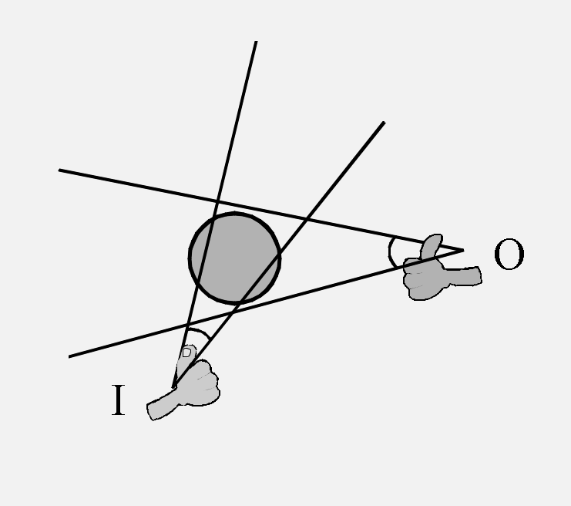
Are you “in” or “out” of an invisible circle around each tree?
Just use an angle to decide that.
Imagine using your thumb.

Slide 7
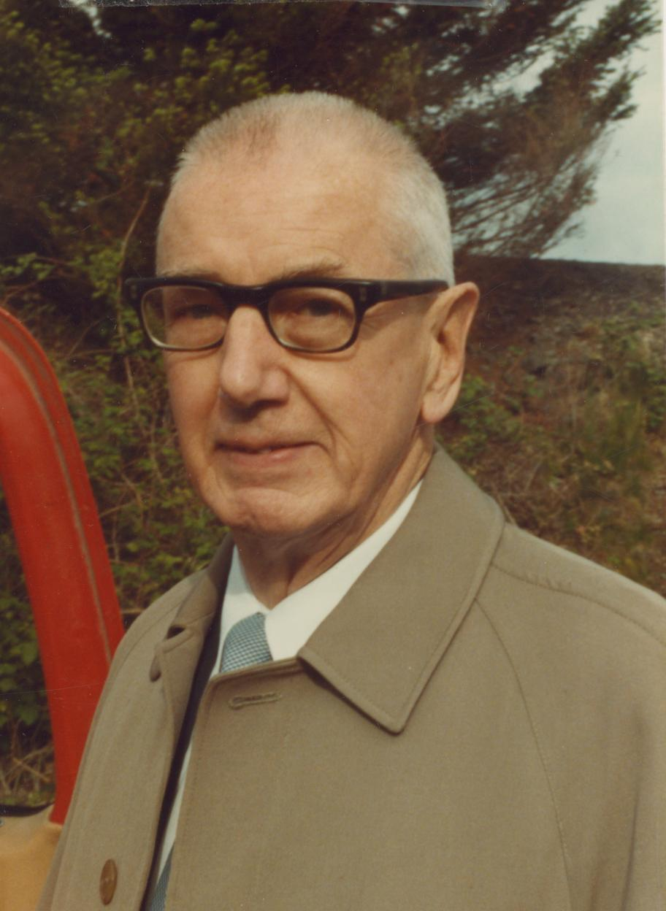
Lew Grosenbaugh immediately reads about this idea in 1947.

Slide 8
He thinks …
If you have the basal area, just find out how much is “sitting on each square foot” to calculate any other stuff.
This Value / Basal Area Ratio is
called “VBAR”.

Slide 9
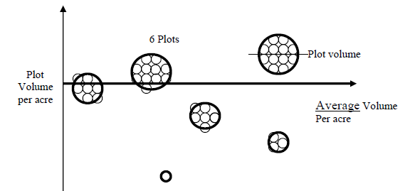
Grosenbaugh treated it like a Fixed Plot

Slide 10
Next, Don Bruce

Slide 11
Mason Bruce and Girard (1950) introduce
“Count and Measure” plots.
Just measure the trees on some of the plots, only counting trees on the others.
Sum plot Vol’s / Sum plot BA’s = Ratio
If plots were too far apart, people lost their nerve … at about a 4 or 5 counts per measure.

Slide 12
How it is done
1) Do all plots for some easy and quick
variable (basal area, in this case).
Measure some plots for a ratio, then use the
ratio to convert all the other basal areas.
PS … You do the same tree measurements with
any of these systems.

Slide 13
Key points
1) These trees are measured in “clusters”
on the measured points.
2) Many counts are done to improve the final result.

Slide 14
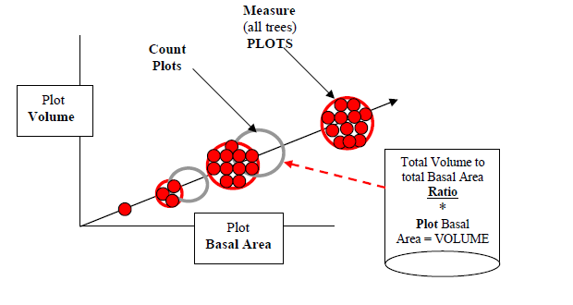
It’s called “Double Sampling” and uses Plot volumes & BA’s
4
6

Slide 15
There is sampling error in the average Basal Area and the Vol/BA correction.
Volume
?? Ratio of volume to Basal Area
Right Ratio ?
Measure plot volume
vs. estimate using BA.
BA
Average BA ?

Slide 16
The statistical formula is messy for Double Sampling
Known as
“Johnson’s Formula” in forestry

Slide 17
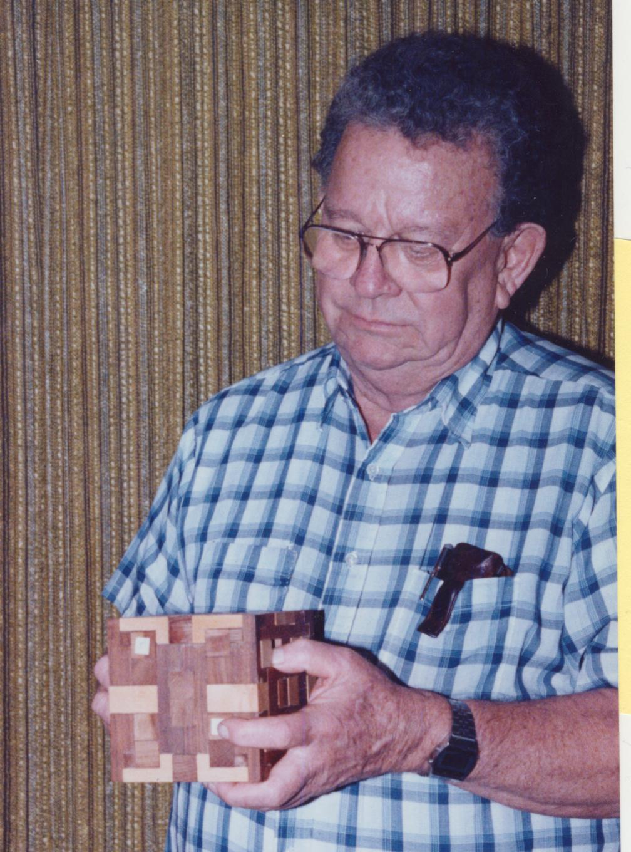
Next, DAVE Bruce – the son

Slide 18
He said : A “Product Estimator” could also be used here.
(Dave also invented the wedge prism)
(1) Find BA somehow m²
(2) Find the VBAR somehow m³/m²
(3) Multiply them together = m³
This clearly separates steps (1) and (2), although we often do both on the same sample points.

Slide 19
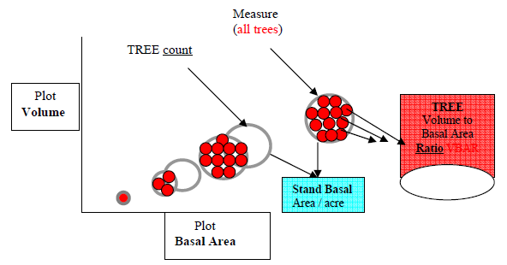
The “Product Estimator” with count/measure plots = same answer
27
6

Slide 20
Easy Statistics : (Bruce’s Formula)
(SE% basal area plots) ²
SE% combined = +
(SE% VBAR trees) ²
Combined SE%
VBAR SE%
Basal area SE%

Slide 21
A 30 year gap …
Finally - Big BAF sampling (1980)
Now you systematically “spread out” the trees through the stand, and get about
double the affect of taking trees in clumps on “measure plots”.
The advantage is the Systematic Sampling

Slide 22
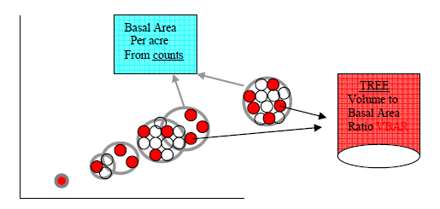
BIG BAF : Spread out the tree measurements
6
15

Slide 23
How it is done
Choose the trees to count by a small angle,
this gives you the stand basal area.
Choose just a few measured trees with a large
angle to find out their Volume/BA ratio.
If the BAF is 5 times larger, you get 1/5th the trees, and they are closer and easy to see.
Other methods to “spread out” VBARs
(see the John Bell Newsletter for these)

Slide 24
How many of each type? (TC vs. VBARs)
Effort in each type is pretty much given by :
CV of Tree Count vs. CV of VBARs
40% and 30% indicate [40 counts & 30 trees], in multiples sufficient for the SE% you want.
There is a simple EXCEL spreadsheet for the
exact sample size computation.

Slide 25
What data matters?
It’s easy to tell – just add or subtract data and compile the results to see if anything changes.
Beliefs do not matter here …
this is algebra, not theology
It is usually the case that you need more counts.

Slide 26
What will more measured trees do for you?
Tree measurements will give better percentages to log products.
These products will never be known better than the basal area they are multiplied by.
All totals will change proportionally with BA for virtually all variables (BF, Grade, $, etc).

Slide 27
What will more Count Plots do for you?
Tree measurements will give better
percentages by species and better BA.
Much better efficiency for the cruise.
Better anything that uses Basal Area
in its compilation.

Slide 28
VBAR
Usually done by measuring a tree for its total volume, then dividing by that tree’s basal area at DBH.
VBAR = Volume / tree basal area = m³/m².
“Solid cylinder height”
There are other ways as well.
DBH

Slide 29
Another way to get VBAR
Estimate the logs in the tree (MB&G, 1950’s) for logs/m², then get m³/log to correct that.
The extra units cancel out …
m²/ha * logs/m² * m³/log = m³/ha

Slide 30
More ways to get VBAR
Use a percentage of tree or stand height ,
roughly (total tree height / 3) = m³/m²
Use the vertical distance to where the tree is “borderline” (“critical height”, use Relascope).
Use “Pressler’s Height” (use Relascope).
Use historical data .

Slide 31
What data should you see?
Any computer program needs to report
how variable the TC and VBAR are.
(The “CV” statistic for each).
VBAR can be any tree measurement divided by the tree basal area (giving statistics).
The program should give you the measured tree data, so you can research it on your own.

Slide 32
What is next?
3P sampling, which :
  Makes quick estimates for everything.
  then corrects those estimates.
  3P is good for anything, not just trees.

Slide 33
Thanks for your patience
I know it’s not scaling, but
You are the timber measurements society.

Slide 34
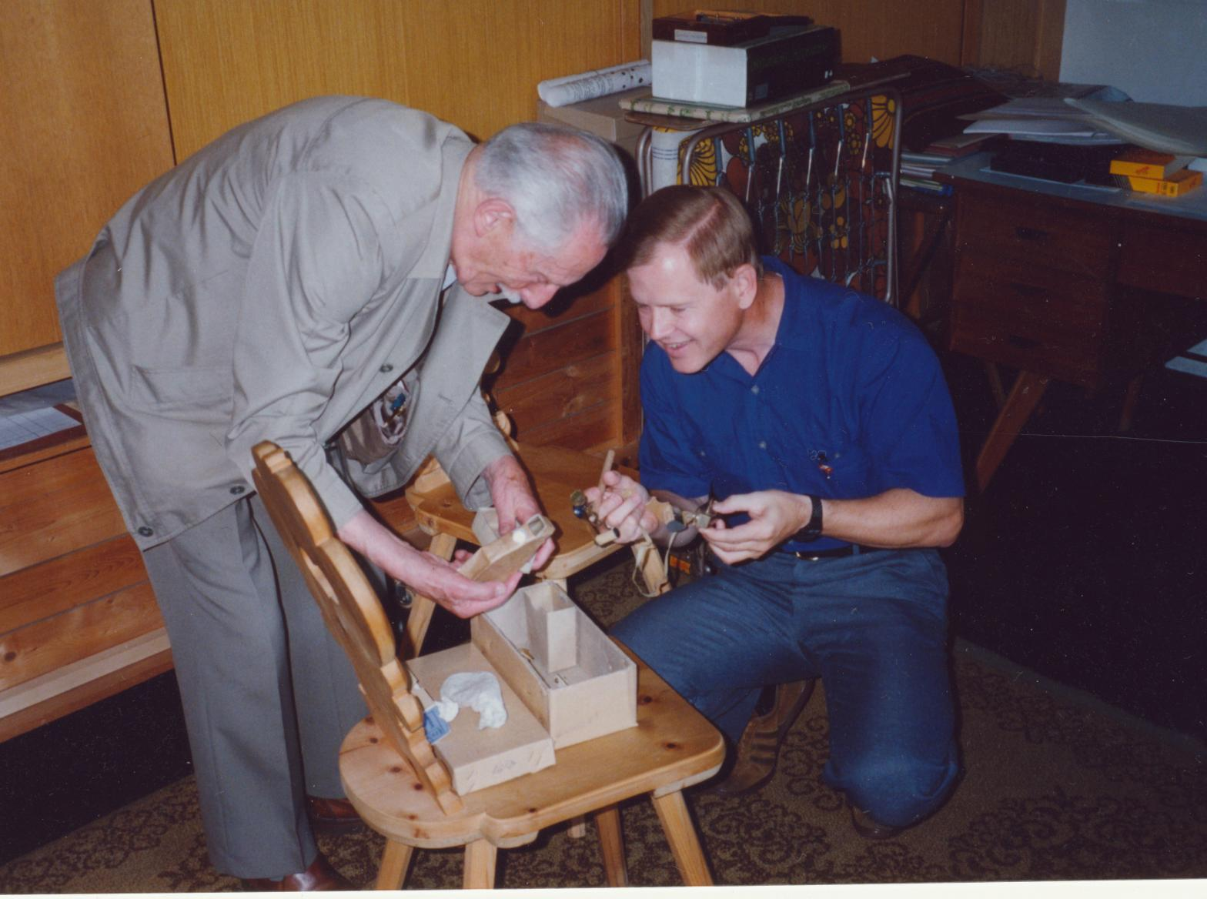
Some instruments of cruising, for you to look over later.

Slide 35
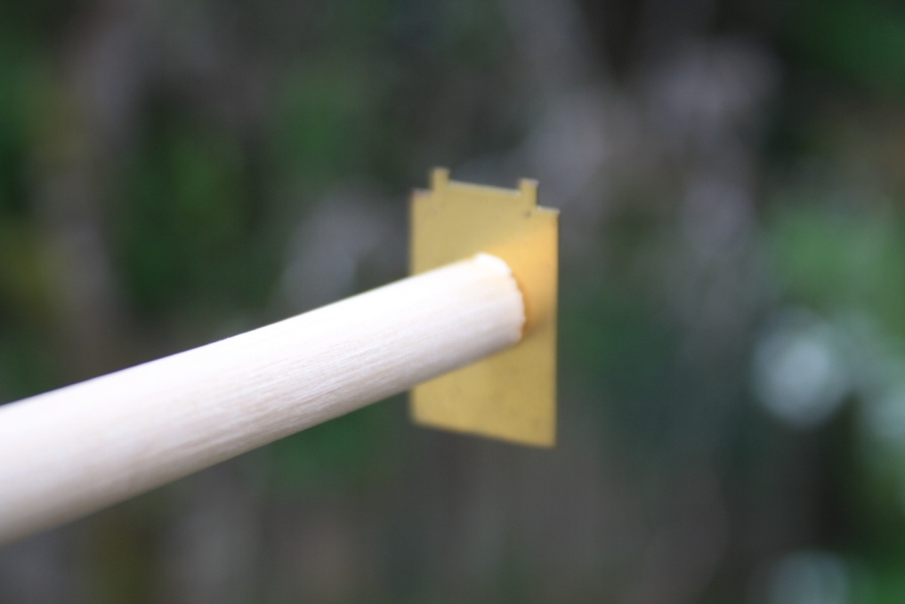
The first Relascope target

Slide 36
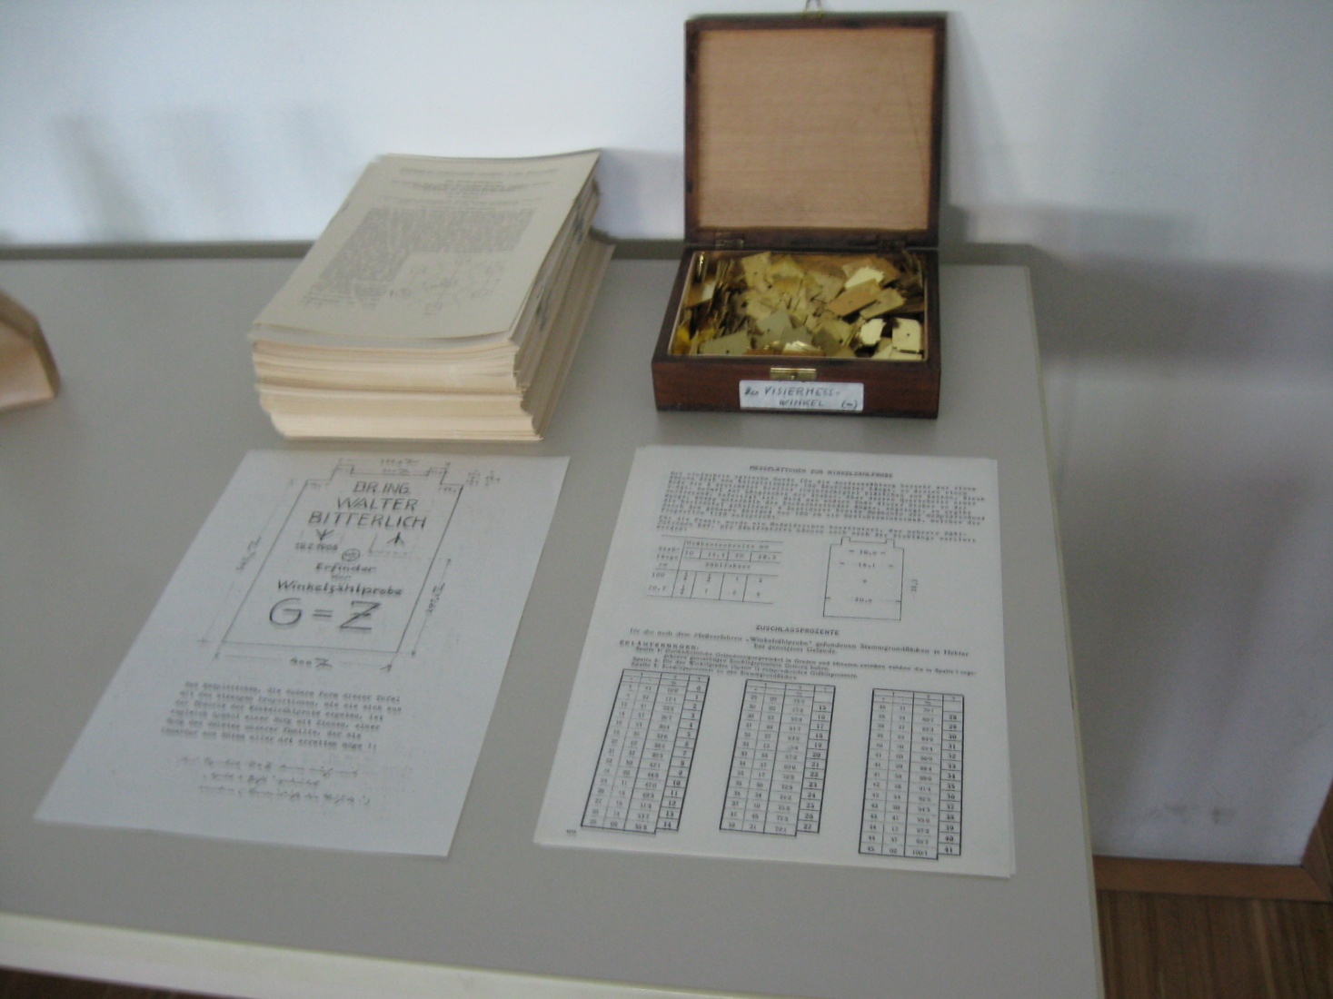
Bitterlich wanted this target etched on his tombstone

Slide 37
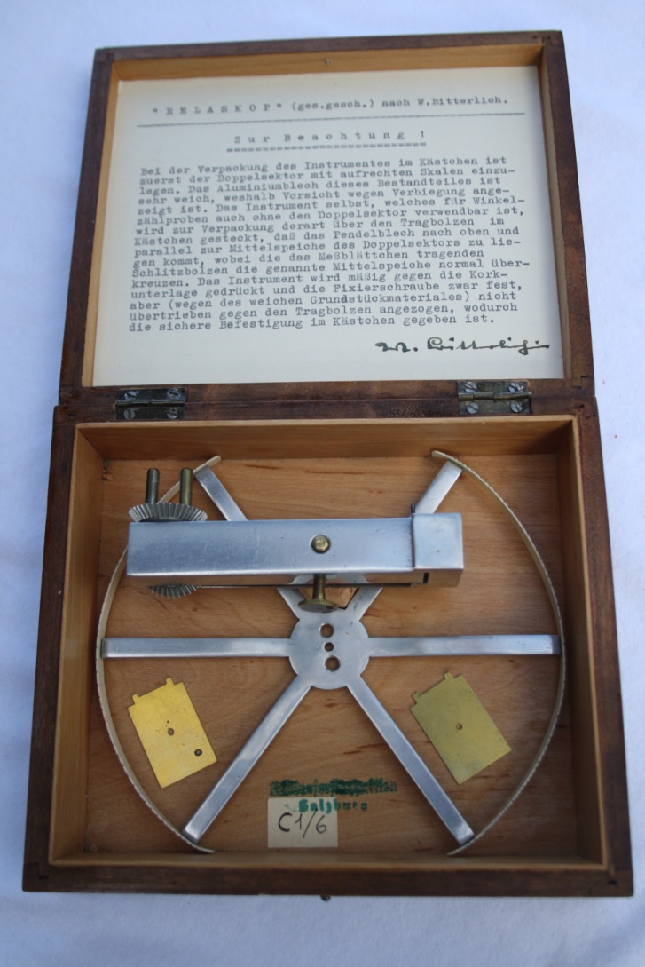
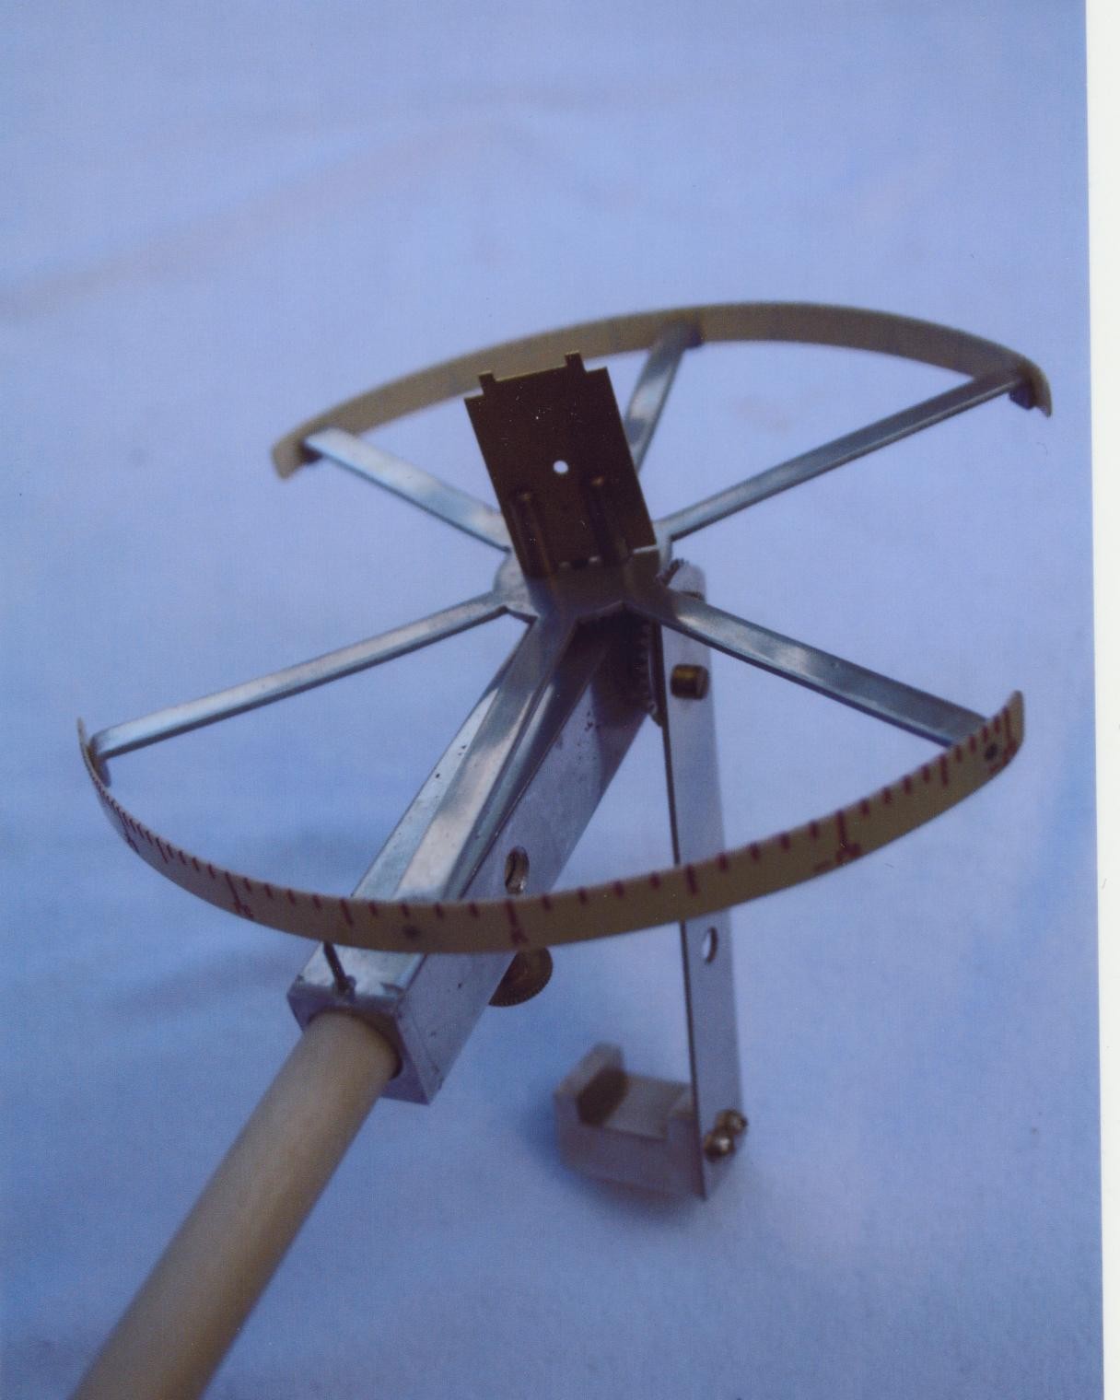
Bitterlich’s first Relascope

Slide 38
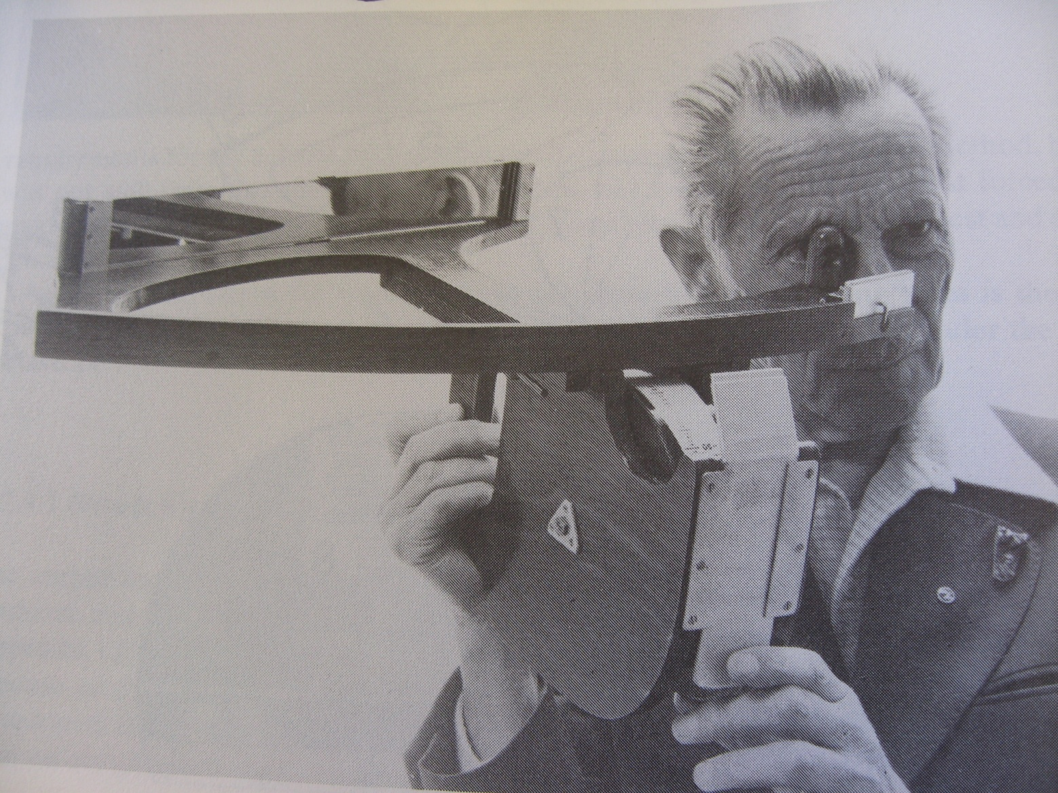
Bitterlich’s Wooden Relascope

Slide 39
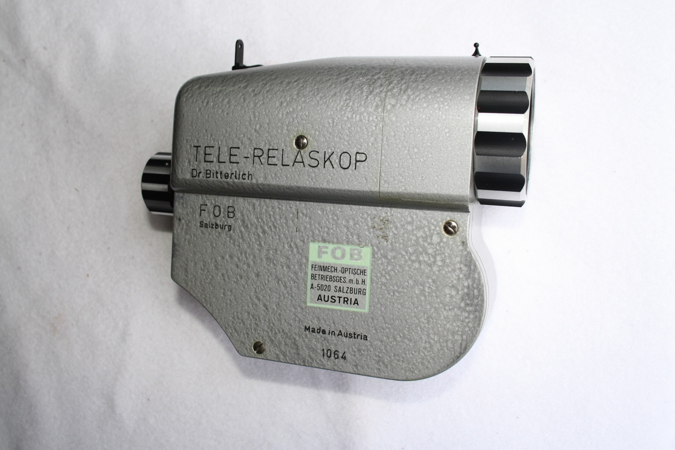
The 8-power Relascope

Slide 40
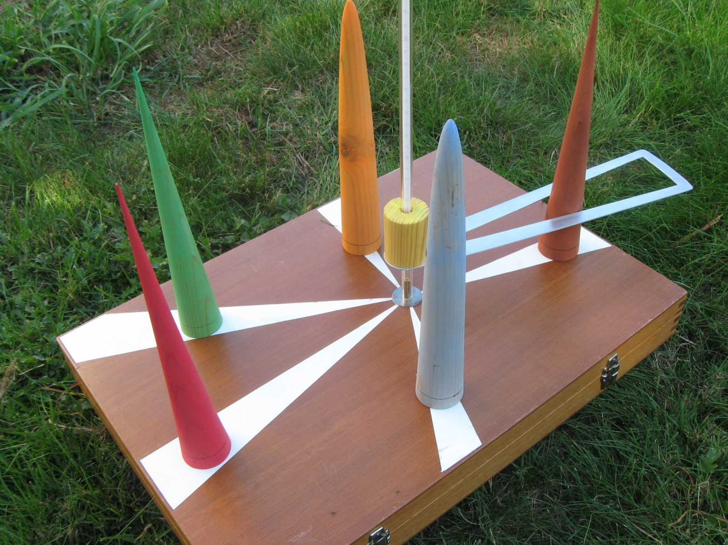
The Bitterlich teaching tool
2, 3, and 4 dimensional VP sampling

Slide 41
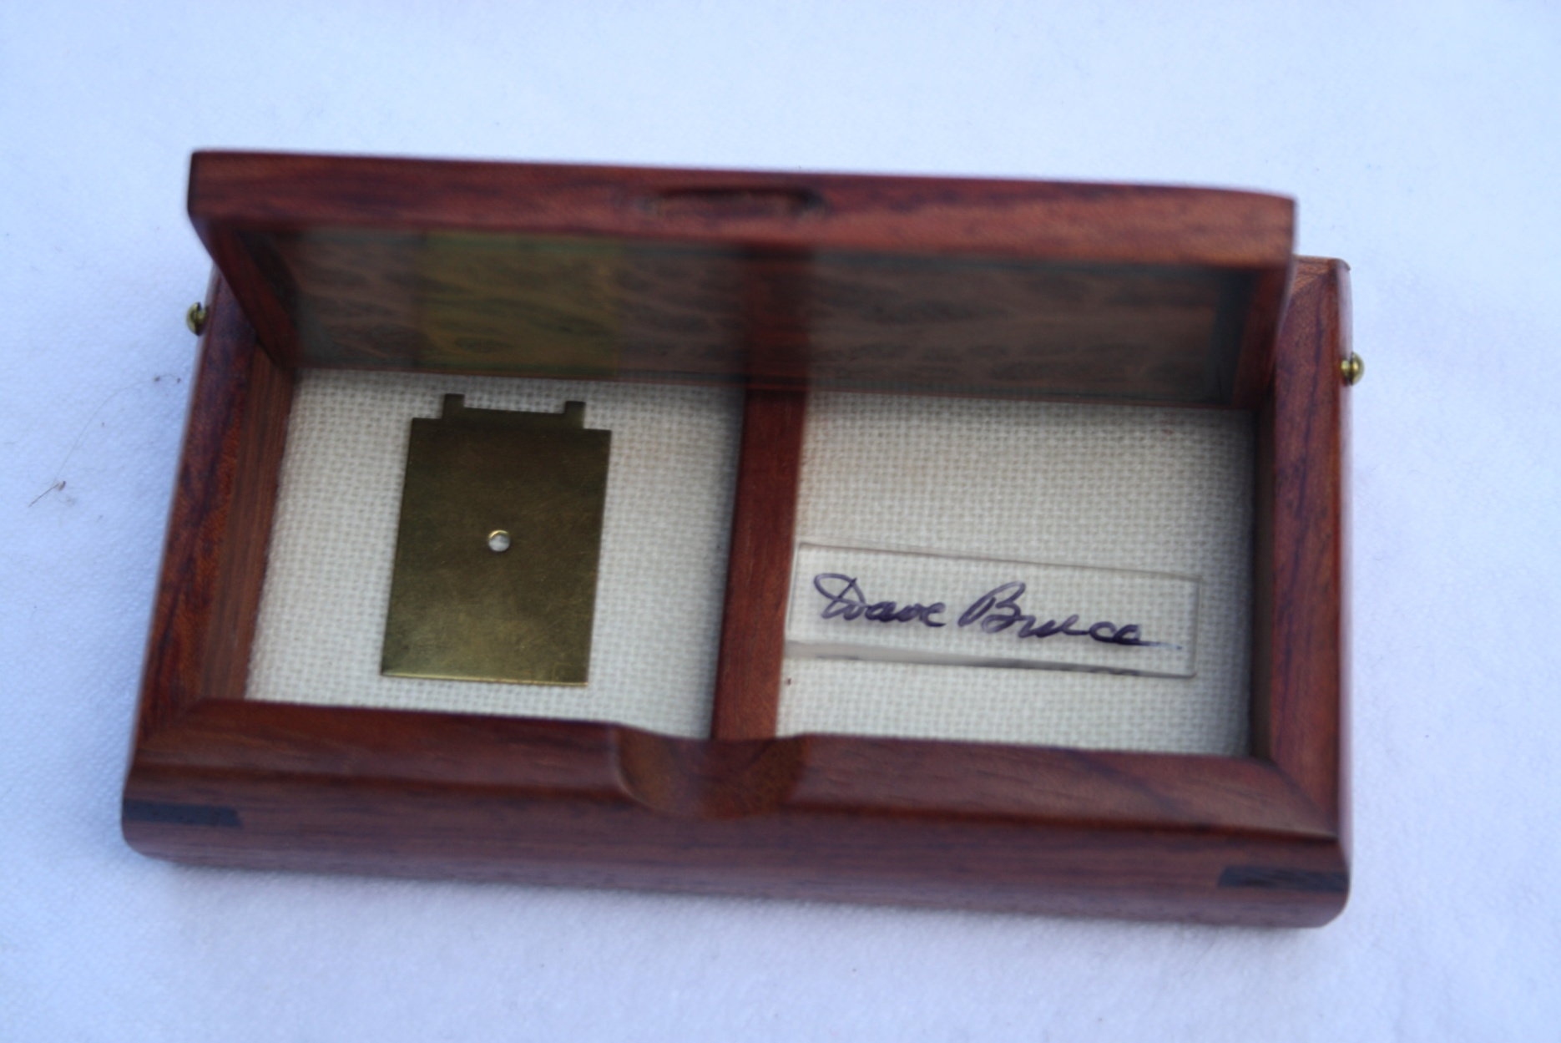
The first “wedge prism”

Slide 42
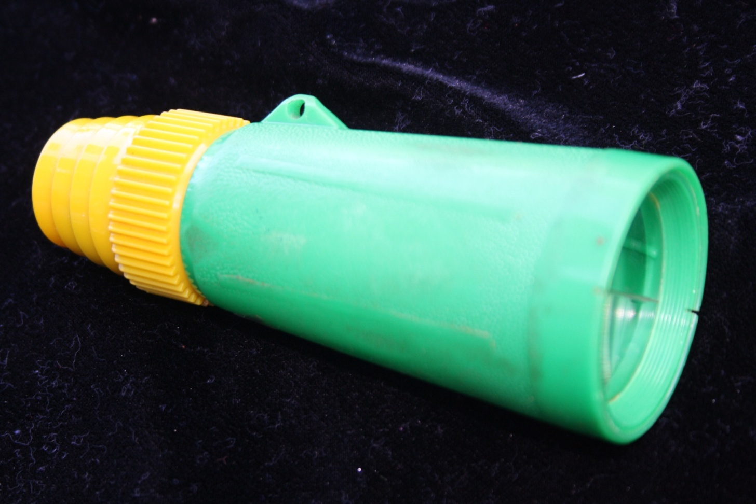
The first published prism (6X)

Slide 43
Also, some handouts on …
VP sampling (and the story of its
development, according to Bitterlich)
Prism Cruising
Story of the development of it (by Bruce)

