Slide 1

Forest Professionals in timber cruising
SITCA 2017
Casey Macaulay RPF
Registrar and Director of Act Compliance
Notes:
1
1

Slide 2
knowledge
risk
Managing public assets
education
Reliance and trust
Right to practice
competence
Right to title
accountability
STEWARDSHIP
Notes:
2
2

Slide 3
FORESTERS ACT
S.4(2)
The objects of the association are:
to uphold the public interest respecting the practice of professional forestry by
  ensuring the competence, independence, professional conduct and integrity of its members, and
  ensuring that each person engaged in the practice of professional forestry is accountable to the association

Slide 4
DUTIES AND EXPECTATIONS
WE ARE RESPONSIBLE TO FOUR GROUPS
Bylaw 11 Code of Ethics
Forest Professional
Employer Client
Public
Other Members
Profession

Slide 5
BYLAW 11 CODE OF ETHICS
11.1 All members, however and wherever they may practice, are bound by the Code of Ethics..
11.3 The responsibility of a member to the public is:
  11.3.2 To uphold professional principles above the demands of employment.
11.4 The responsibility of a member to the profession is:
  11.4.1 To inspire confidence in the profession by maintaining high standards in conduct and daily work.
  11.4.6 To keep informed in the member’s field of practice and to be aware of current issues and developments in forestry.

Slide 6
11.5 The responsibility of a member to the client or employer is:
  11.5.1 To act conscientiously and diligently in providing professional services.
  11.5.3 To obtain a clear understanding of the client’s or employer’s objectives.
  11.5.4 To accept only those assignments for which the member is qualified...
11.6 The responsibility of a member to other members is:
  11.6.2 Not to unfairly criticize the work of other members or attempt to injure the professional reputation or business of another member.

Slide 7
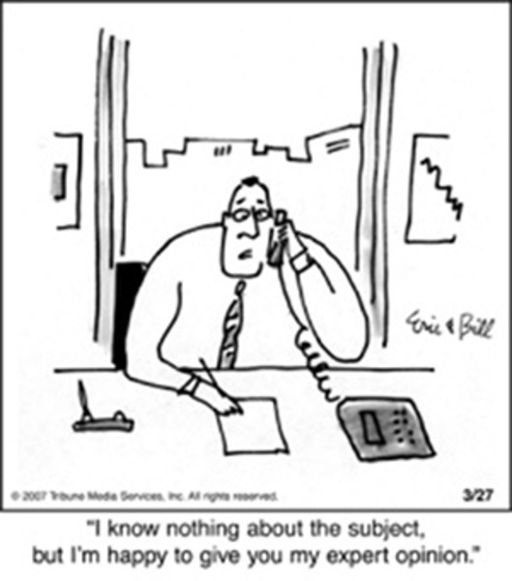
COMPETENCE
WHAT MAKES US COMPETENT TO DO THIS WORK?

Slide 8
BYLAW 12 STANDARDS OF PROFESSIONAL PRACTICE
12.2.1 Competent members maintain sufficient knowledge in their field(s) of practice.
12.2.2 Competent members ensure their work is complete, correct and clear.
12.2.3 Competent members exercise appropriate judgment and discretion with due care.
12.2.4 Competent members provide professional work that is measurable or verifiable and can provide a rationale as to the methods used in measuring or verifying.

Slide 9
QUALIFICATIONS, COMPETENCE AND AUTHORITY
Competence is defined as knowledge and skill acquired through education and experience.
Authority is a legally assigned level of “right to practice”. It cannot be accepted unless it has been assigned.
Qualification is a standard of compliance. An individual must be both competent and have the legal authority, to be qualified.
A professional is qualified when he/she has both legal authority and competence.

Slide 10
Competence = Knowledge + Completeness + Care

Slide 11
SUPERVISION
Section 2(3) (b) (i) of the Foresters Act allows non-members to engage in the practice of professional forestry while under the supervision of a registered member.
A forest professional acting independently who supervises other members or non-members must carry out and document due diligence to ensure that the other members or non-members are capable and competent to carry out those duties.
The supervising forest professional is legally accountable, per aspect of authority, for all work carried out under their supervision, be it direct and or indirect.
Giving a forest professional or non-member a manual, plan, instructions, etc. on its own does not constitute supervision

Slide 12
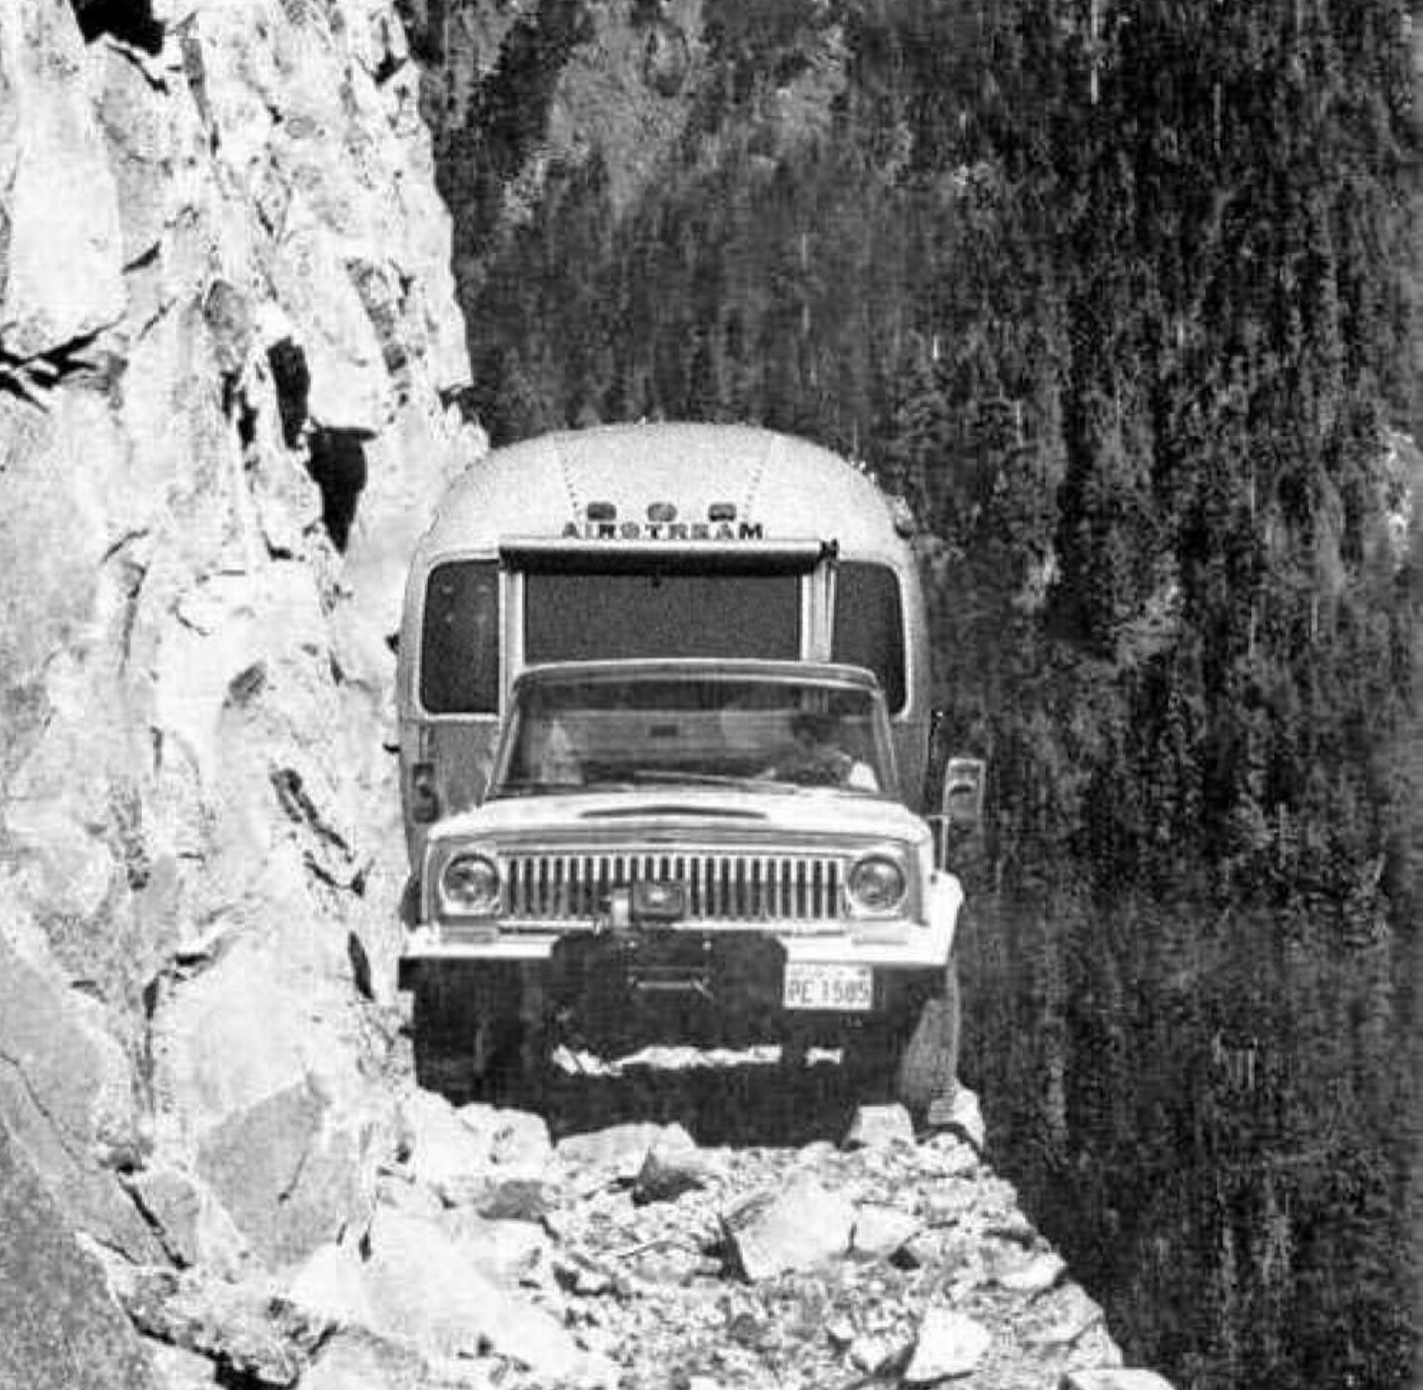
CONDUCT AND RISK
HOW DO WE MANAGE RISKS?

Slide 13
FOREST ACT
Complete and accurate information - 105.1
(3) The holder of an agreement who is required under the agreement or this Act to submit information to the government
(a) for use in determining, redetermining or varying a stumpage rate, or
(b) for any other purpose under this Act,
must ensure that, at the time the information is submitted, the information is complete and accurate.

Slide 14
CRUISE DATA SUBMISSION STANDARDS
The following conditions must be met. If they are not met, then the cruise data may not be used for an appraisal:
The field data must be consistent with the data used in the appraisal compilation.
The field data must be compiled in a manner that is consistent with the cruise plan. (most recent amendment)
The cruiser must take responsibility for the cruise data by either:
Signing, printing their full name and dating (day, month and year) the original cruise card and any subsequent changes they made to that data, or
Submitting a cover letter (including name, date and signature) with the cruise data indicating which plots they cruised or made subsequent changes to.

Slide 15


VALUE
HOW DOES OUR WORK PROVIDE VALUE TO CLIENTS AND THE PUBLIC?

Slide 16
EXPECTATIONS
Employer
Responsibilities in legislation
Social licence
Commercial success
The employer engages the professional to achieve these.
  However,
If the professional fails to apply their professional role, either as a result of their own doing, or a result of employer influence then social licence erodes and we operate in a very short term existence.

Slide 17
ROLES
NAVIGATING YOUR PART
RFT functions and accountabilities place an emphasis on shorter time frames, stand level issues, practical skills, and operating within technical parameters, guidelines and protocols
RPF functions and accountabilities encompass all aspects of professional forestry, including those that may be performed and assumed by an RFT
RFTs may engage in aspects of the practice of professional forestry to the extent consistent with their education, training and experience
Even though aspects of cruising and cruise planning/designing may be procedural based, the consequences of a misunderstood or misdirected modification of these procedures can be serious in nature.

Slide 18
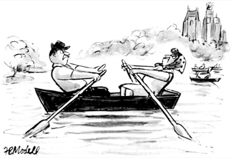
RESOLVING DISPUTES
BECAUSE SOMETIMES WE JUST DISAGREE
Challenges within your organization
Challenges between organizations
Understand each other’s business objectives
Provide enough time for review and consideration
Respect each other’s competence and position
Stop making assumptions
Trust requires relationship and investment
Focus on the work not the personalities
Consider using a third party (is the dispute mechanism adequate?)
Be transparent
Talk to each other
Escalation to a professional complaint

Slide 19
CRUISING ACCREDITATION
Registered members
RPF, RFT
Enrolled members
FIT, TFT
Special permit holders
Limited licenses
Associate members
For non-members

Slide 20
HOW TO APPLY
1
2
3
4
5
6
7
APPLICATION
APPLY AT WWW.ABCFP.CA
ACADEMIC RECORDS
SUBMIT COPIES OF PAST CERTIFICATES
RESUME
PROVIDE A CURRENT RESUME
INDICTABLE OFFENCES
COMPLETE THE FORM
WORK EXPERIENCE
SUBMIT TWO CONFIDENTIAL REPORTS
CRUISER’S LOG
PROVIDE EVIDENCE OF WORK COMPLETED
ETHICS EXAM AND FEES
NON-MEMBERS MUST COMPLETE AN EXAM

Slide 21
Questions?
cmacaulay@abcfp.ca
www.abcfp.ca

