Slide 1
Cruising Manual Update 2017
Presented by:
Beth Eagles, RPF
Cruising Policy Forester
Timber Pricing Branch – FLNRO
Victoria, BC
Beth.eagles@gov.bc.ca
250-387-8307

Slide 2
Background
New Manual in effect as of April 1, 2017.
http://www2.gov.bc.ca/gov/content/industry/forestry/competitive-forest-industry/timber-pricing/timber-cruising/timber-cruising-manual
Many items were presented at last conference.
Many comments received and considered – Thank you!

Slide 3
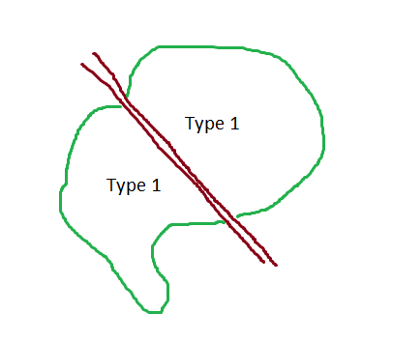
Summary of Changes – Chapter 1 and 2
New definitions for firmwood, net merchantable area and soundwood.
Clarification that Timber Sales must maintain cruise plans on file.
Polygons that are connected by a constructed linear tenure cannot be considered the same type (vs separated).

Slide 4
Summary of Changes – Chapter 2
Rewording of maximum grid size – no material change
Clarification that maximum ratio of count to measure is 3:1 (except where waiving SE)
Waiving SE – not restricted to only 100m, 70 m or 50 m grid
4.0 tree/plot must be on a block basis regardless of grid size
Each cutblock must have its own local grid
Types may have different grid intervals, but must originate from same POI as block. Where grids are reduced, they must also be reduced from this point.

Slide 5
Summary of Changes – Chapter 2
Rectangular grids are not permitted.
Licensees must notify district as to whether grids will be square or staggered on identifiable unit.
New procedure for determining maturity of timber for the purposes of re-cruising.
Orphan tree moved to nearest measure plot in same timber type with same BAF.
Options for orphan trees as a result of office changes are listed in order of preference.

Slide 6
Summary of Changes – Chapter 3
Final cruise submission must indicate whether cruise or scale based (cruise plan form and check form updated)
Final cruise submission must include actual plot locations
Direction of travel and strip line location not required for GPS in final cruise submission
Removal of contour lines as requirement on cruise plan/final cruise submission

Slide 7
Summary of Changes – Chapter 3
Sample population of check cruise is to be determined by check cruiser
Minimum number of plots is only required to reject based upon tree data attributes or plot slopes. Survey and area measurement standards do not require this minimum.
If rejection is based on measure plot data, must check a minimum of measure plots.
If fewer plots have been checked and there is mutual agreement, the cruise may be rejected or accepted.

Slide 8
Summary of Changes – Chapter 3
Clarification of 5.0 m minimum from PRP to cruise plot
Plot slopes: either standard can be exceeded to be incorrect (>90% of all slopes within +/- 5.0%, average variation of all slopes within +/- 5.0%)
Clarification of check cruise dispute mechanism – written complaint must be submitted to DM within 30 days of site visit

Slide 9
Summary of Changes – Chapter 4
Reference tree - can measure slope or horizontal distance and can measure to point below stump height or nearest point on tree, but must indicate how it is done
Reference point - used to determine position of cruise plot if original marker is missing, should last until check cruise
PRPs - cannot be a tree that is large enough to incur deflection
Where GPS standards cannot be met, plot must be located using conventional methods
BAF can only be changed to a value within 50% of original

Slide 10
Summary of Changes – Chapter 4
Watch for odd shaped trees when assessing in or out
If shatter extends through DBH and either standing or down portion is out of plot, assess portion of tree with greater than 50% basal area at DBH to determine in/out
If a boundary tree is going to be stubbed, apply walkthrough method if it is in
When assessing unmarked boundary for walkthrough purposes, project a line between outer most face of merchantable trees
Date on back of cruise card must be date field work completed, not date signed

Slide 11
Summary of Changes – Chapter 5
Percent reductions in compilation – where range of stems is specified, use average number in range
Must consider whether dead trees will be reserved in percent reductions. If tree class or live/dead is not specified, both live and dead trees must be reserved and not be damaged/removed.

Slide 12
Appendices
Updated PSYU Cross Reference Procedure for Mapview
New wording around grey attack trees – may apply benefit of doubt, but cruisers are still expected to examine and make notes where possible
Extensive shallow charring definition
Blowdown code E and G clarified. Matrix added back in.
Species 10 m log tables
Updated magnetic declination table
Clarification that F. pinicola is only called on large, old wounds on live trees

Slide 13
Thank you!
Beth Eagles, RPF
Cruising Policy Forester
Timber Pricing Branch – FLNRO
Victoria, BC
Beth.eagles@gov.bc.ca
250-387-8307

